Slide 1
Partial Derivatives, Gradients, & Directional Derivatives

Slide 2
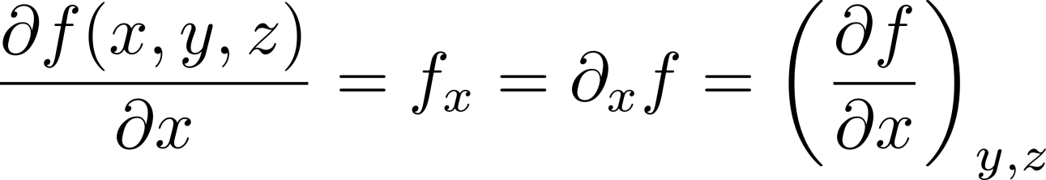
Notation

Slide 3
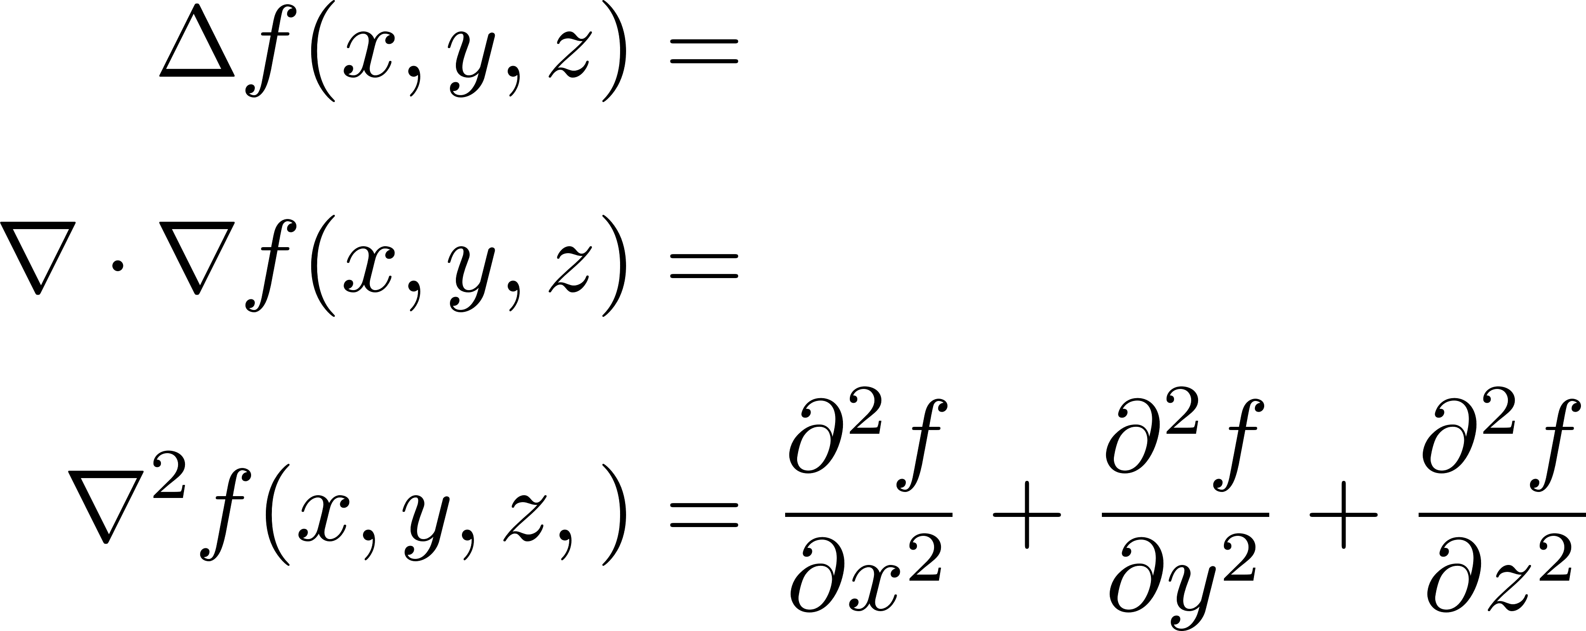
Laplacian

Slide 4
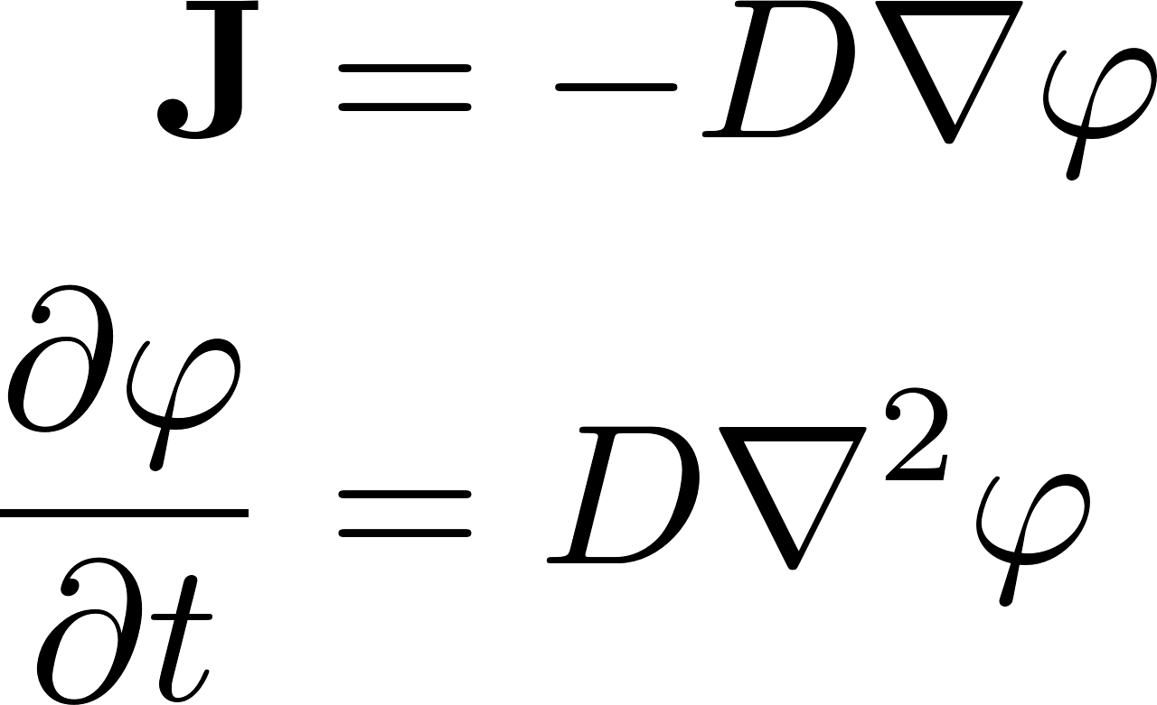
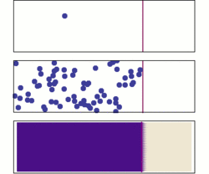
Fick’s Laws of Diffusion

Slide 5
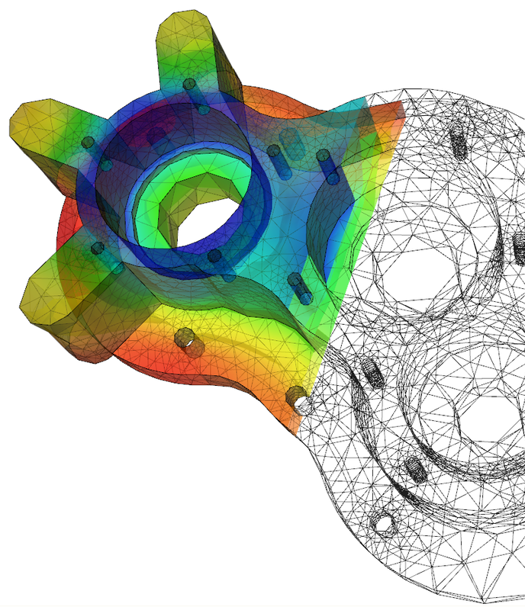
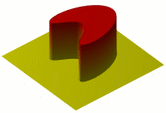
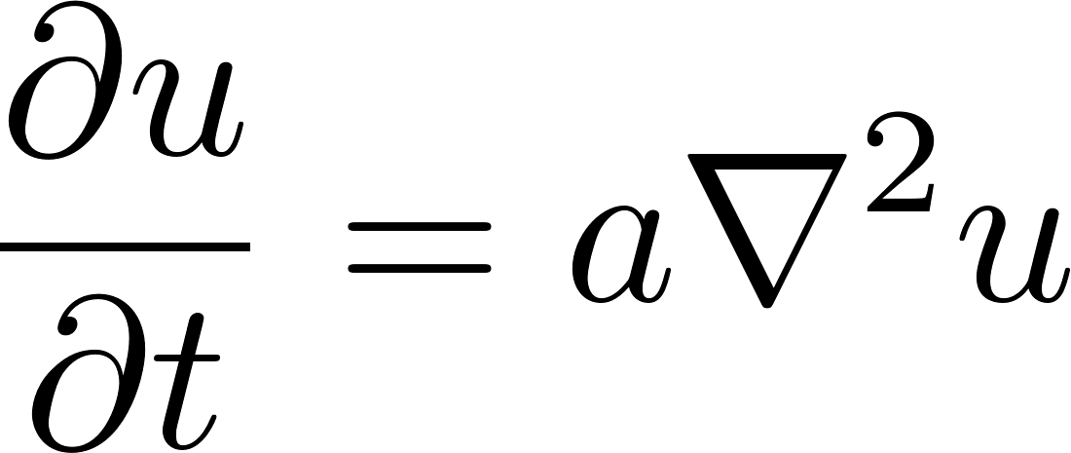
Heat Equation
Notes:
Heat equation takes exact same form as Fick’s second law.

Slide 6
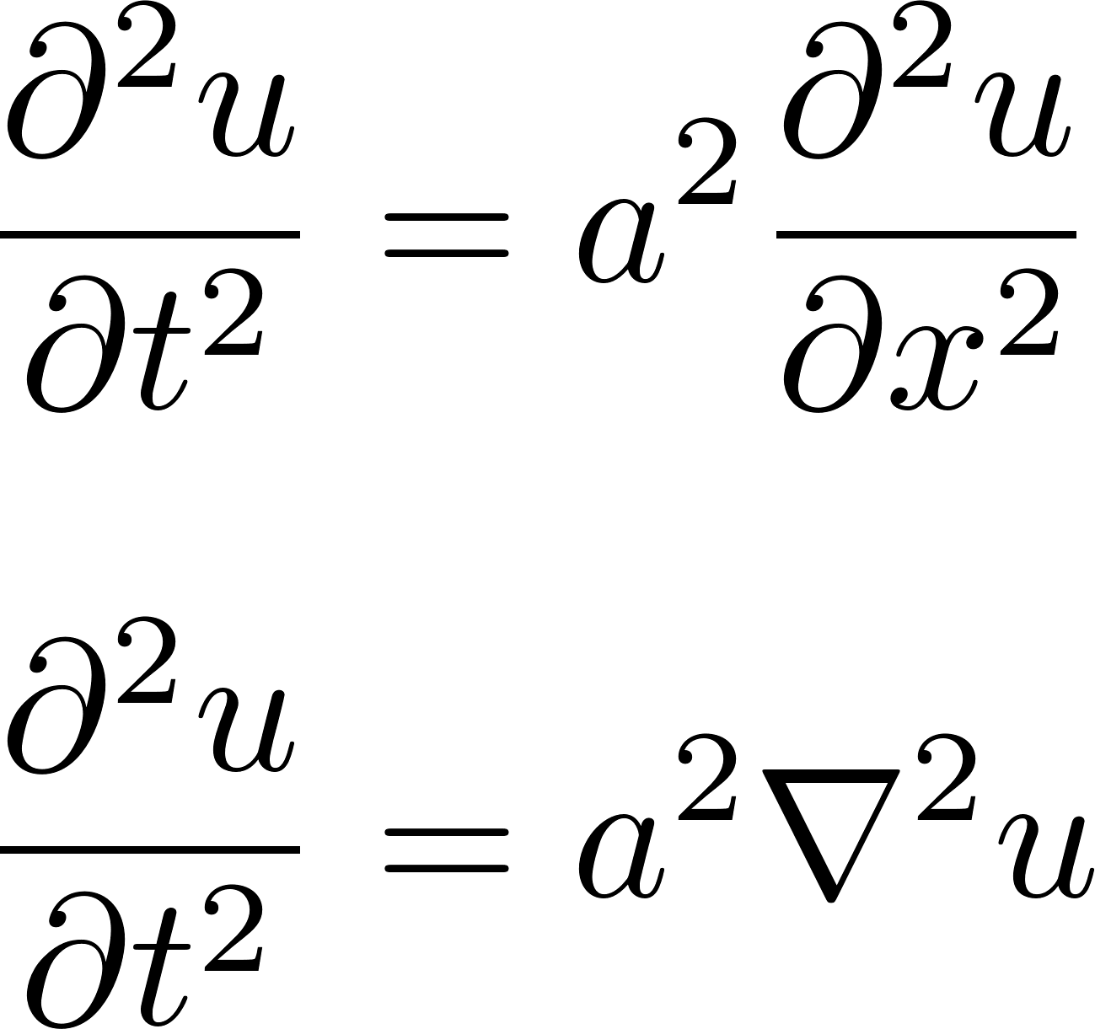

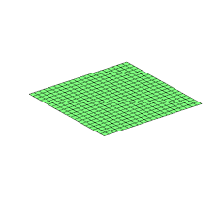
Wave Equation

Slide 7
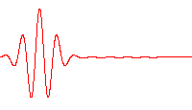
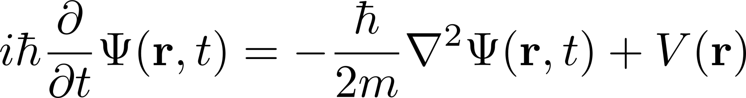
SchrÖdinger Equation
Notes:
Relates energy of quantum system to its partial with respect to time. Schrodinger awarded 1933 Nobel Prize in Physics for his work. Like F=ma, the Schrodinger equation can be used to predict future system states from the present conditions.

Slide 8
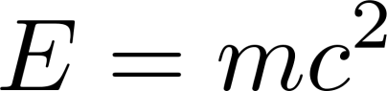
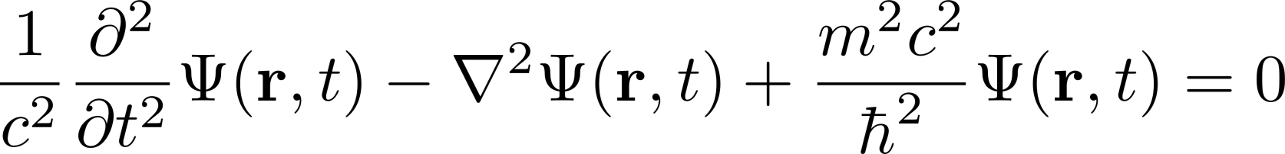
Klein-Gordon Equation
Notes:
The quantum mechanical analog of mass-energy equivalence.

Slide 9
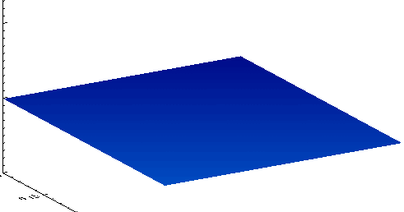
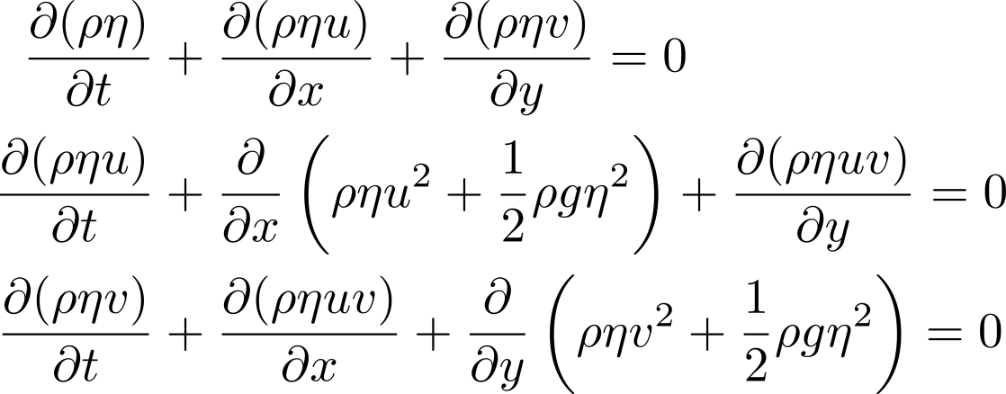
Shallow Water Equations
Notes:
Derived from the Navier-Stokes equations, when the horizontal scale is much larger than the vertical. Eta is fluid column height, rho is the fluid density, u and v are the components of fluid velocity.
The SWEs can be used to predict tides, storm surge levels and coastline changes from hurricanes, ocean currents, and to study dredging feasibility.

Slide 10
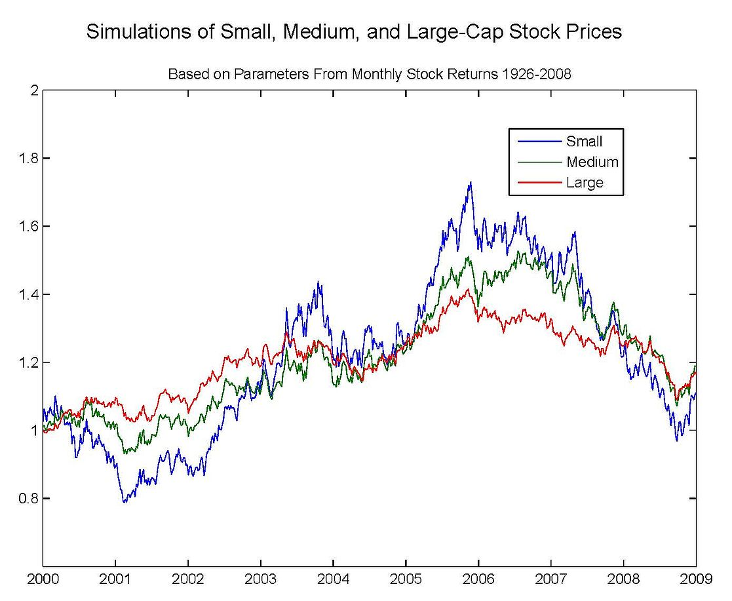
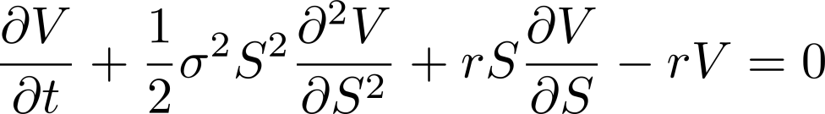
Black-Scholes Equation
Notes:
V = option price, sigma = volatility, S = stock price, r = interest rate. Only works in European markets in this form due to some of the assumptions, but has been modified for other markets. Myron Scholes awarded 1997 Nobel Prize in Economics (Black ineligible due to his death in 1995). Credited with revolutionizing options trading in the 1970’s.

Slide 11
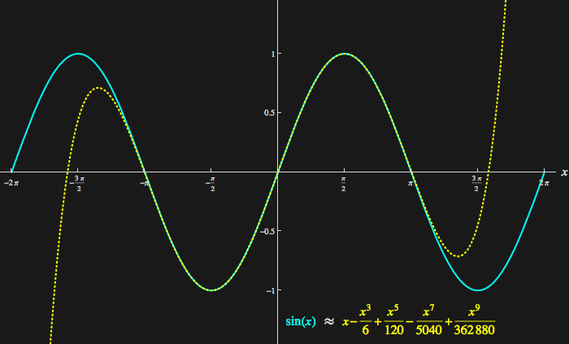
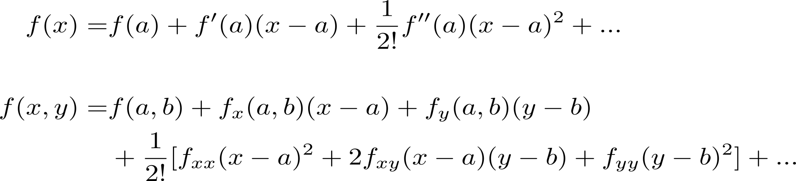
Taylor Series

Slide 12
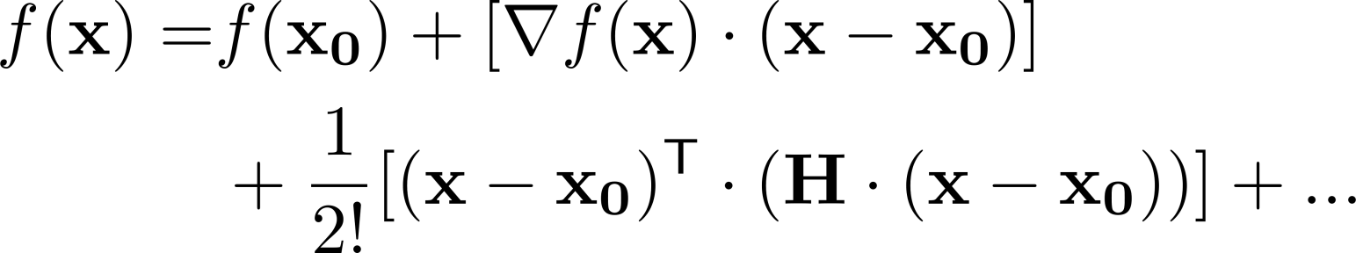
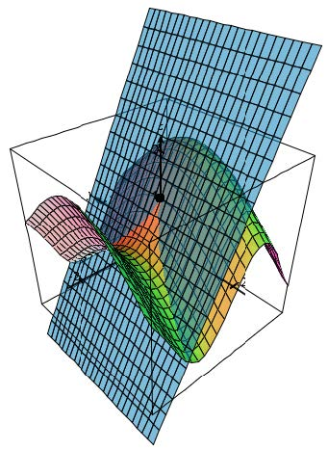
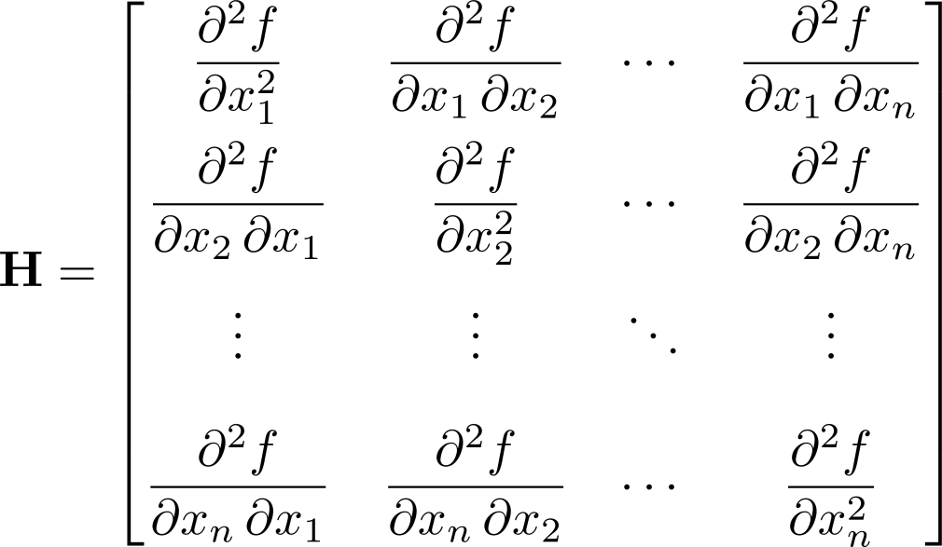
Generalized Taylor Series

Slide 13
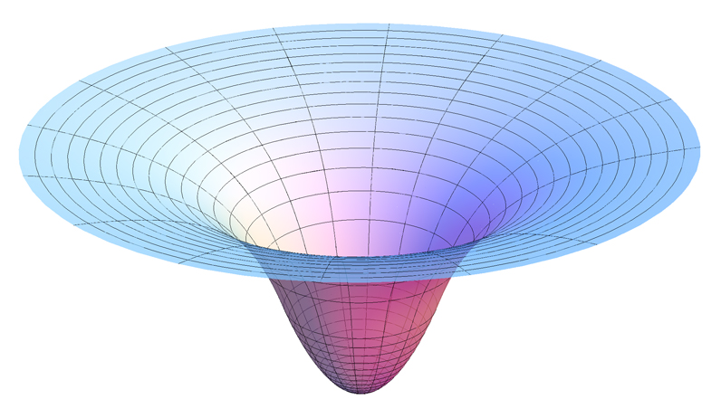

Forces and Potential

Slide 14
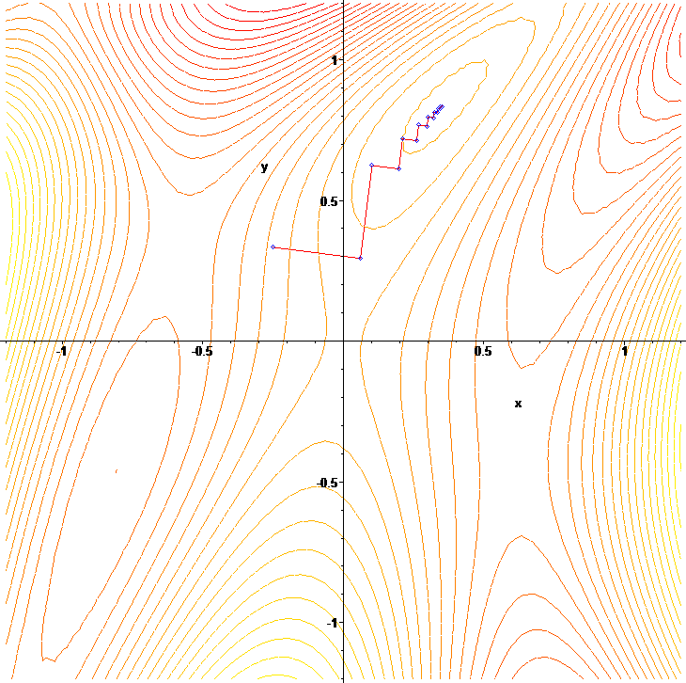
Gradient Descent
Notes:
Iterative numeric method used to find local maxima and minima. Used extensively in machine learning algorithms to optimize parameters of a cost function (i.e. regression equation) since cost function isn’t know analytically.

